Slide 1
Hybrid CNN-TRANSFORMER Architecture for Automated Detection of Dental Periapical Diseases

Slide 2
Outline
Contributions
Background: CNNs, Transformers, and Medical Imaging Challenges
Dataset & Preprocessing
HCNA — Model Architecture (high level)
Implementation Details & Training Protocol
Experiments & Results (Stage 1: Binary classification)
Ablation Studies & Comparative Analysis
Deployment & Clinical Integration
Limitations & Future Work
Conclusion & Key Takeaways
References

Slide 3
Motivation & Problem Statement
Periapical diseases are prevalent and early detection prevents tooth loss.
Manual radiograph interpretation is time-consuming and varies between clinicians.
Existing deep learning methods either capture local texture (CNNs) or global context (Transformers), not both.
Goal: Design a hybrid model that captures both fine-grained local features and long-range spatial dependencies to improve diagnostic accuracy and generalization.

Slide 4
Key Contributions
Proposed HCNA: a hybrid CNN–Transformer pipeline tailored for dental periapical X‑rays.
Two-stage classification strategy — Stage 1 (binary screening) validated with high accuracy (91% on validation).
Practical preprocessing steps including KNN-based cleaning and K-means intensity segmentation to enhance lesion contrast.
Extensive experiments, ablation studies, and deployment-ready inference pipeline.

Slide 5
Background: Why Hybrid?
CNNs: Excellent at local patterns (edges, textures) and translation invariance.
Transformers: Self-attention models capture global dependencies and contextual relationships across the whole image
Medical radiographs need both: local lesion detail and relational context (tooth position, bone relation).
Hybrid models combine inductive biases for better sample efficiency on small medical datasets.

Slide 6
Related Work

Slide 7
Segmented X‑ray Data for Periapical Diagnosis (Data in Brief, 2024)
Deep Learning-Based Efficient Diagnosis of Periapical Diseases (Image & Vision Computing, 2024)
This is a powerful tool in public speaking. It involves varying pitch, tone, and volume to convey emotion, emphasize points, and maintain interest.
Pitch variation
Tone inflection
Volume control
Effective body language enhances your message, making it more impactful and memorable.
Meaningful eye contact
Purposeful gestures
Maintain good posture
Control your expressions

Slide 8
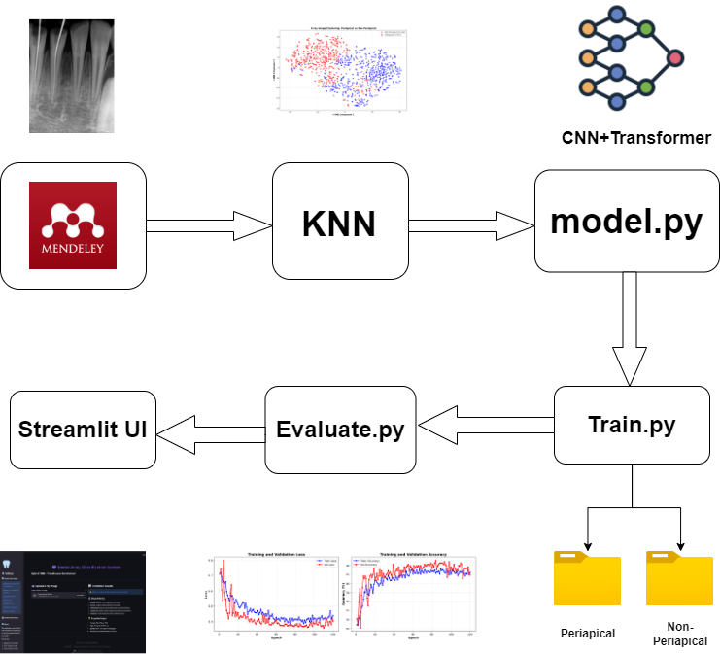
Pipeline

Slide 9
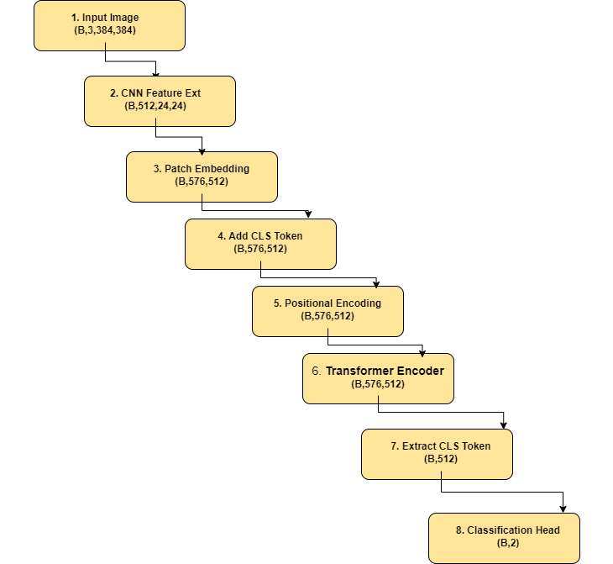
Architecture Diagram

Slide 10
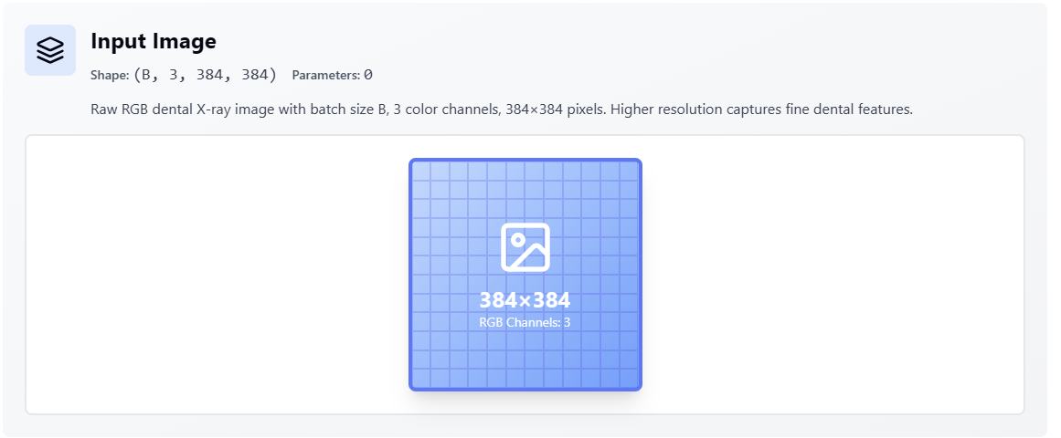
Stage-1

Slide 11
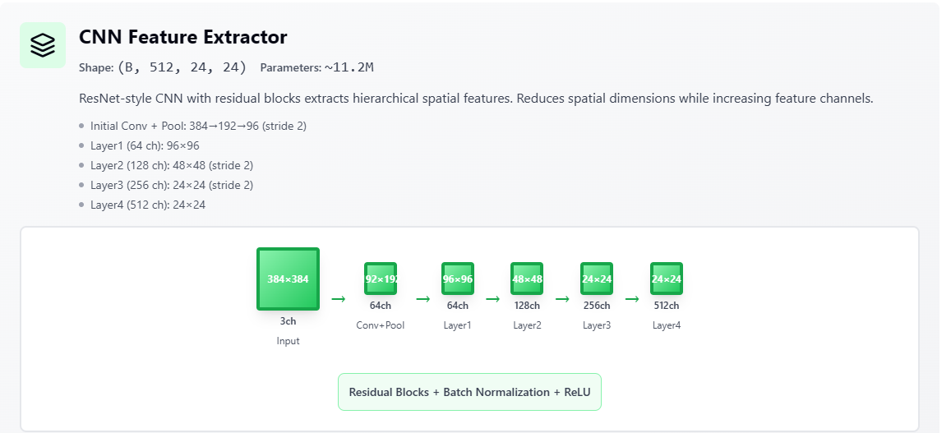
Stage-2

Slide 12
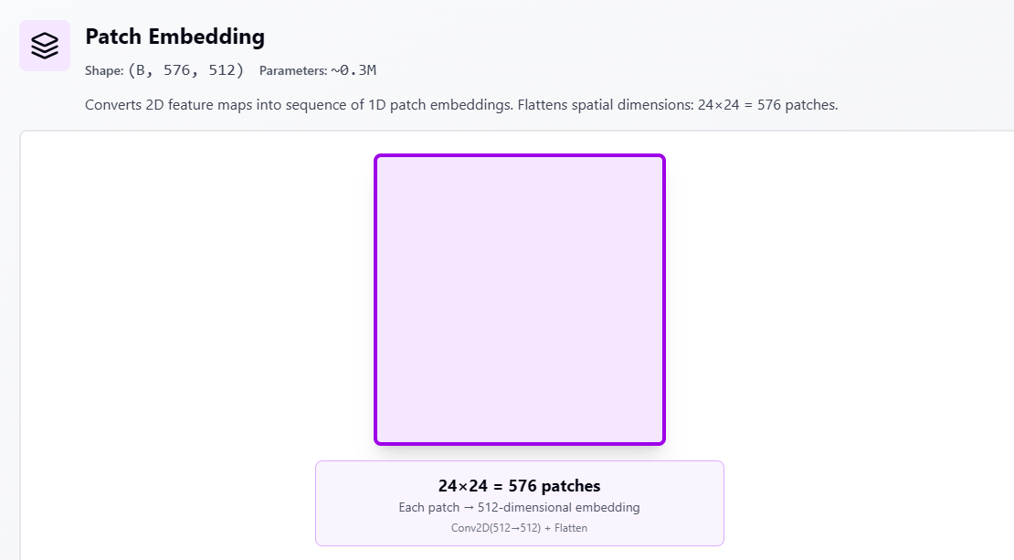
Stage-3

Slide 13
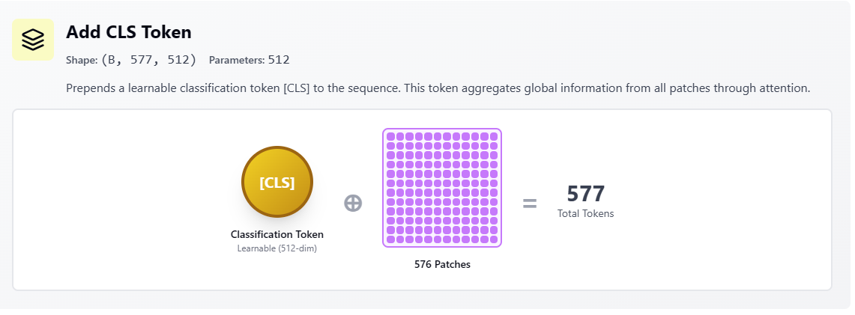
Stage-4

Slide 14
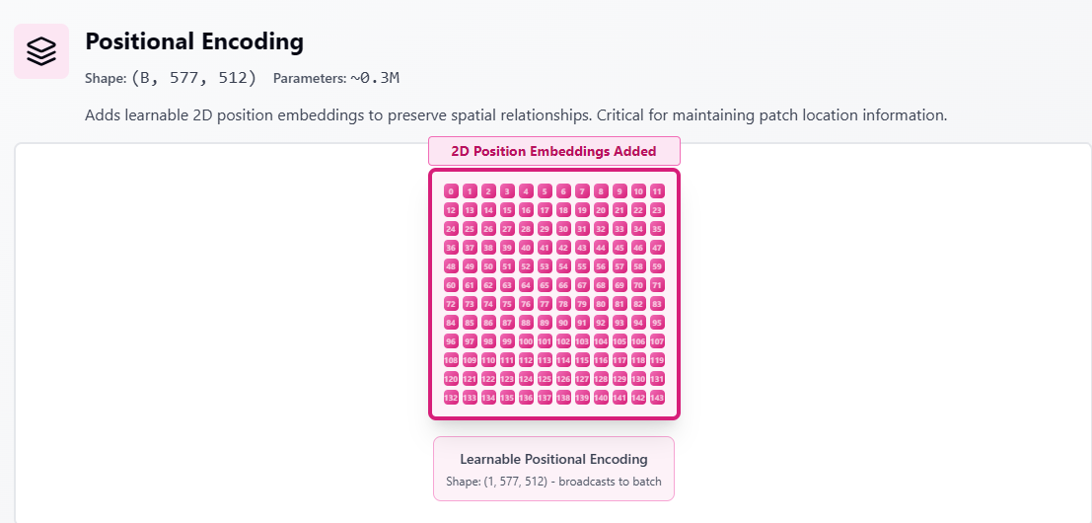
Stage-5

Slide 15
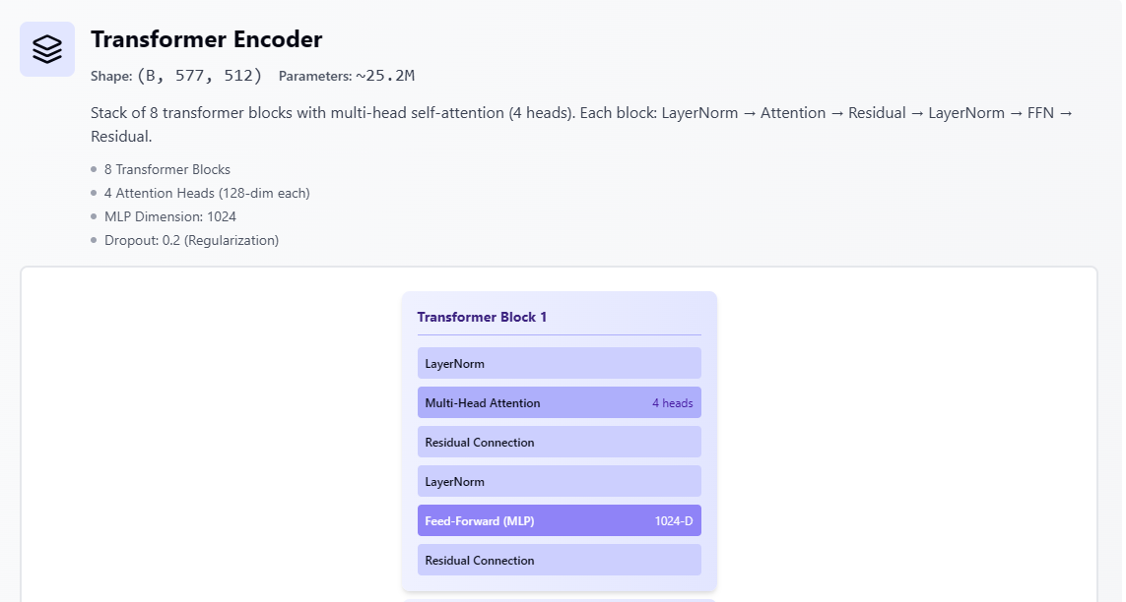
Stage-6

Slide 16
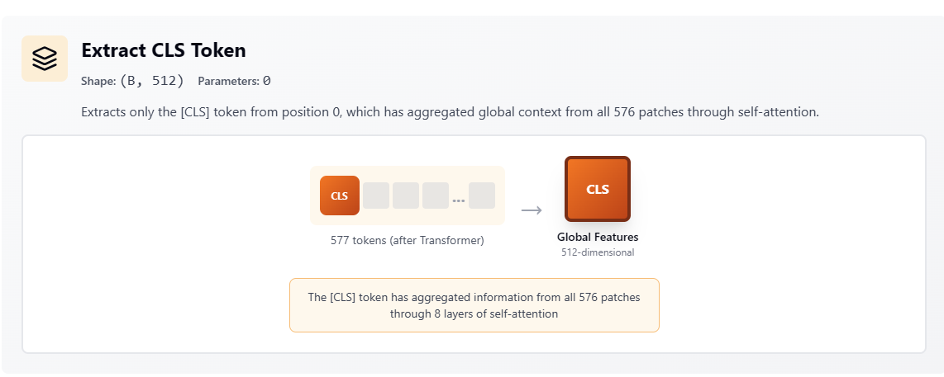
Stage-7

Slide 17
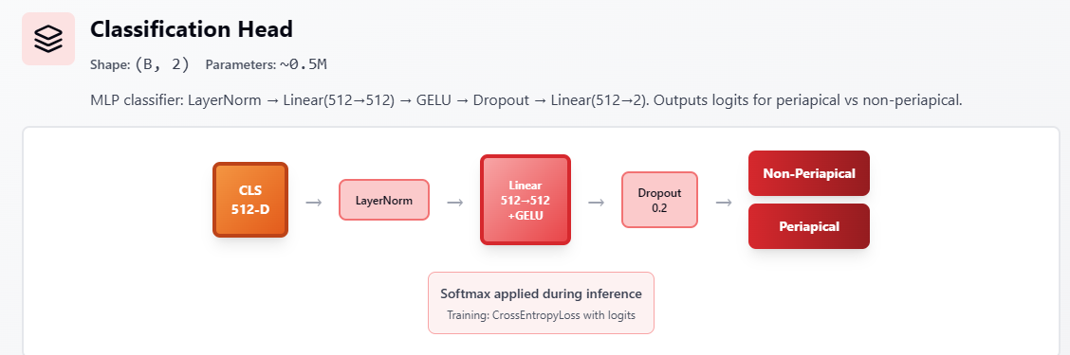
Stage-8

Slide 18
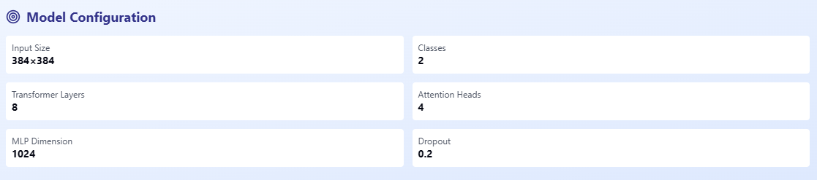
Model Configuration

Slide 19

Training Hyperparameters

Slide 20
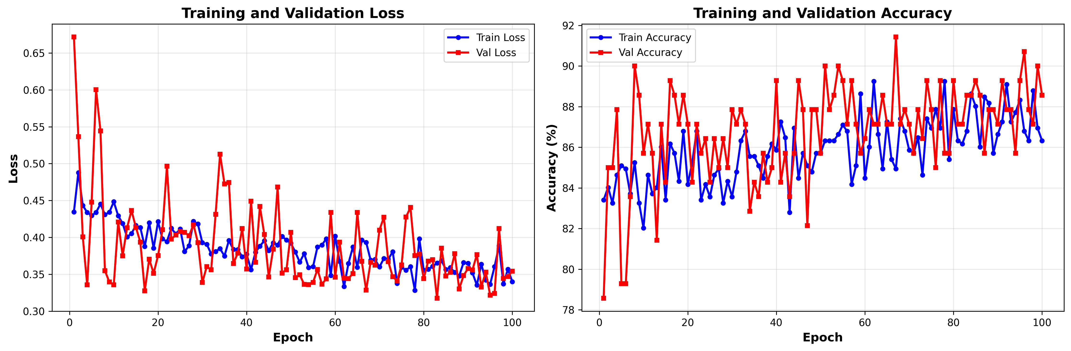
Training & Validation Accuracy Graph

Slide 21
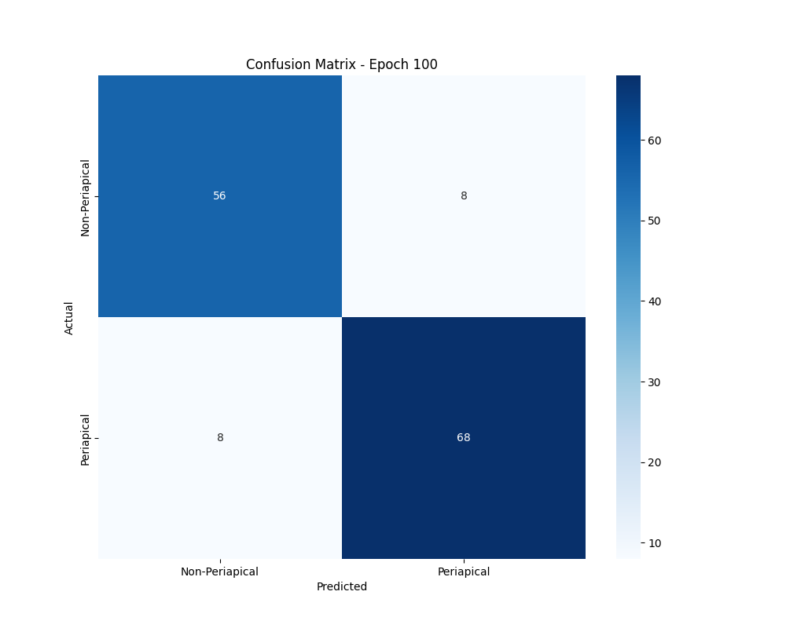
Training & Validation Accuracy Graph

Slide 22
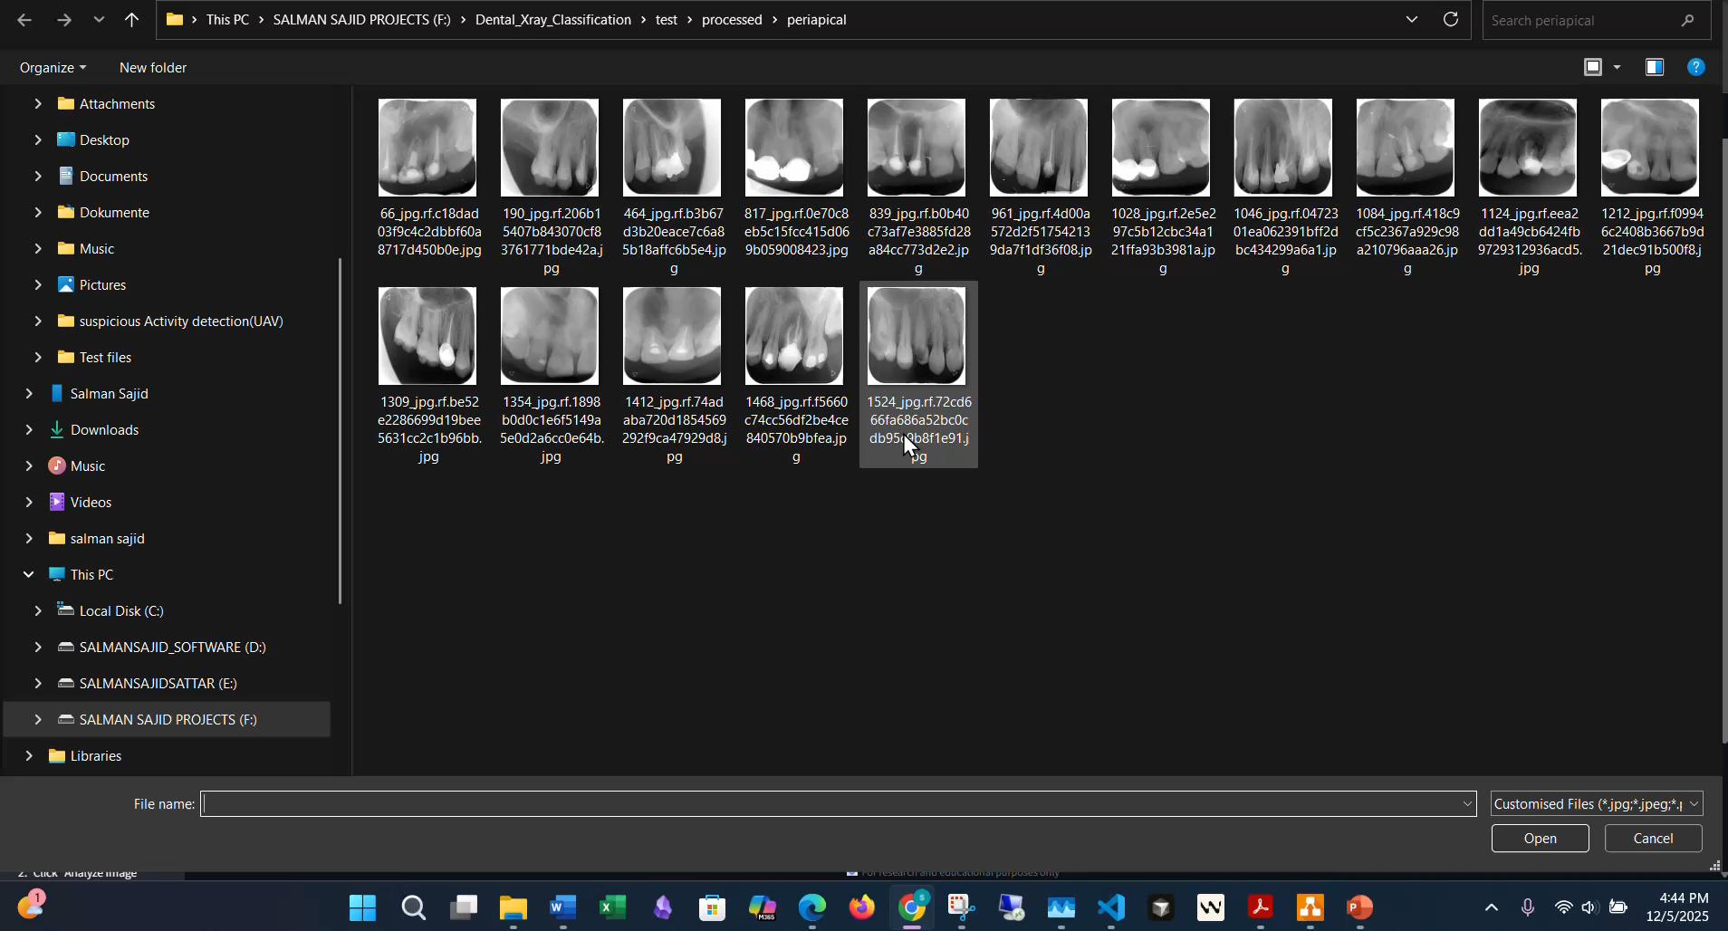

Slide 23
Thank you
Brita Tamm
502-555-0152
brita@firstupconsultants.com
www.firstupconsultants.com

Slide 24
Speaking engagement metrics
Impact factor | Measurement | Target | Achieved
Audience interaction | Percentage (%) | 85 | 88
Knowledge retention | Percentage (%) | 75 | 80
Post-presentation surveys | Average rating | 4.2 | 4.5
Referral rate | Percentage (%) | 10 | 12
Collaboration opportunities | # of opportunities | 8 | 10

